Slide 1
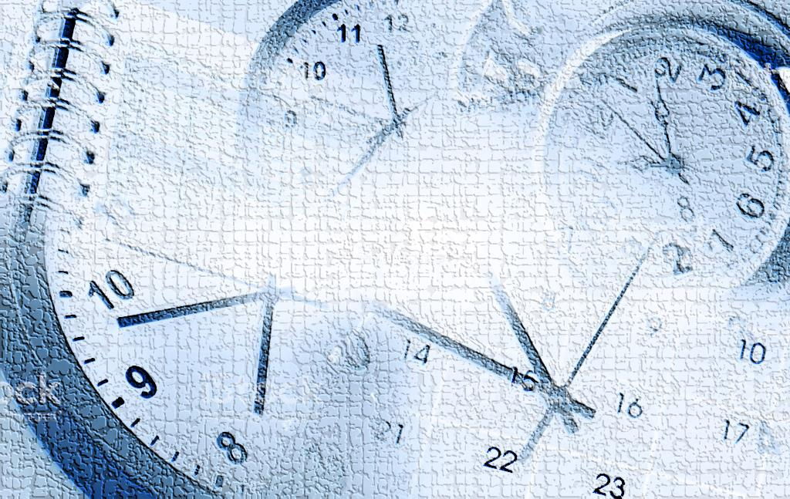
CLOCK

Slide 2
FEW CONCEPTS
In 60 minutes, minute hand gains 55 minute spaces over the hour hand.
Both the hands of a clock coincide once in every hour.
The hands of a clock are in the same straight line when they are coincident or opposite to each other.
When the two hands of a clock are at right angles, they are 15 minute spaces apart.
When the hands of a clock are in opposite directions, they are 30 minute spaces apart.
Angle traced by hour hand in 12 hrs. = 360°
Angle traced by minute hand in 60 min. = 360°.
If a watch or a clock indicates 9.15, when the correct time is 9, it is said to be 15 minutes too fast.
If a watch or a clock indicates 8.45, when the correct time is 9, it is said to be 15 minutes too slow.

Slide 3
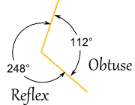
The hands of a clock will be in straight line but opposite in direction, 22 times in a day.
The hands of a clock coincide 22 times in a day.
The hands of a clock are straight 44 times in a day.
The hands of a clock are at right angles 44 times in a day.
A Reflex Angle is one which is more than 180° but less than 360°

Slide 4
There are 4 types of problems on clocks:
1. To calculate the angle between the two hands when time is given.
2. To calculate the time when both the hands will be at some angle.
3. Concept of slow and fast clocks/ Overall gain or loss.
4. Mirror Image.

Slide 5
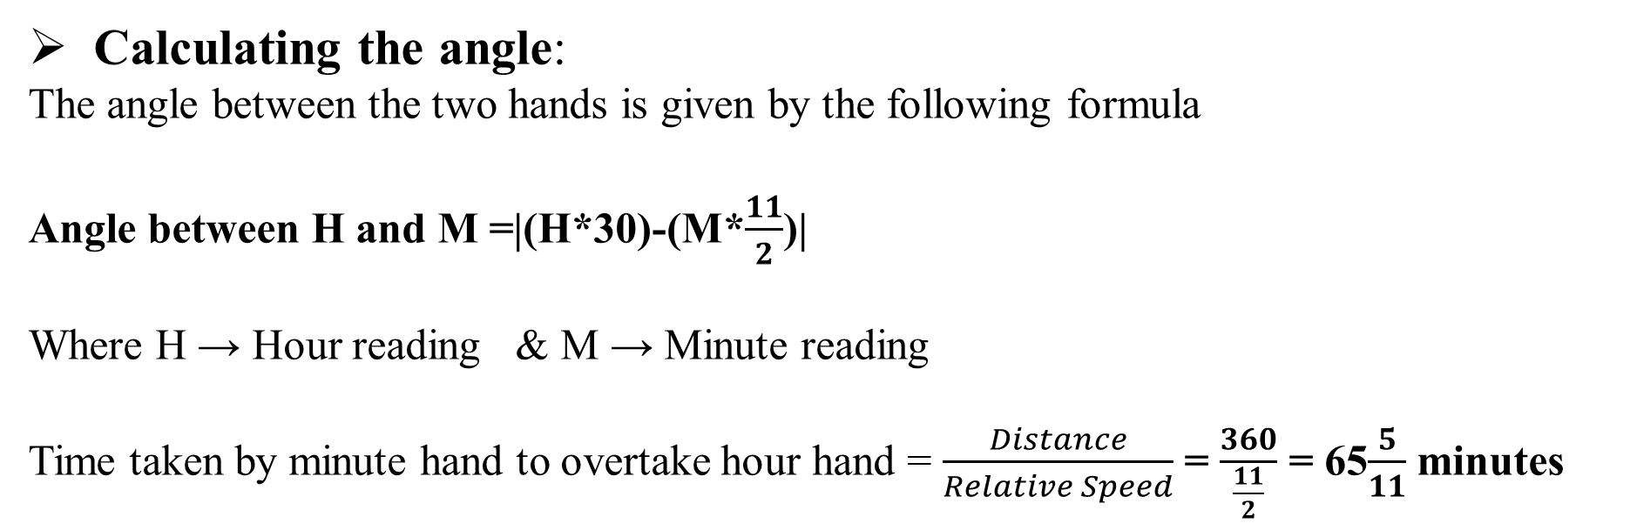
1. To calculate the angle between the two hands when time is given.
Calculating the angle:
The angle between the two hands is given by the following formula
Angle between H and M =|(H*30)-(M*$\frac{11}{2}$)|
Where H → Hour reading & M → Minute reading
Time taken by minute hand to overtake hour hand = $\frac{Distance}{Relative Speed}$ = $\frac{360}{\frac{11}{2}}$ = 65$\frac{5}{11}$ minutes

Slide 6
1. At 3.40, the hour hand and the minute hand of a clock form an angle of:
110 B. 120 C. 130 D. 140
Answer: C
2. An accurate clock shows 8 o’clock in the morning. Through how may degrees will the hour hand rotate when the clock shows 2 o’clock in the afternoon?
A.144° B.150° C.168° D.180°
Answer: D
3. The reflex angle between the hands of a clock at 10.25 is:
180° B.192.5° C. 195° D.197.5°
Answer: D
Notes:
1. Angle traced by hour hand in 12 hrs. = 360º.
Angle traced by it in 11/3 hrs= ((360 /12) *(11/3))° =110°
Angle traced by minute hand in 60 min. =
Angle traced by it in 40 min =(360*40/60)° =240°
Required angle (240 - 110)º = 130°

Slide 7
4. The angle between the minute hand and the hour hand of a clock when the time is 4.20, is:
A.0° B.10° C.5° D.20°
Answer: B
Notes:
3. Angle traced by hour hand in 125/12 hrs.={(360/12)*(125/12)}°= 312(1/2)°
Angle traced by minute hand in 25 min ={(360/60)*25}° =150°
Reflex angle =360° -(312(1/2)-150)°= 360° -162(1/2)°= 197(1/2).
4. Angle traced by hour hand in 13/3 hrs.=((360/12)*13/3)°=130°
Angle traced by min. hand in 20 min. =(360*20/60)° =120°
Required angle = (130 - 120)º = 10º.

Slide 8
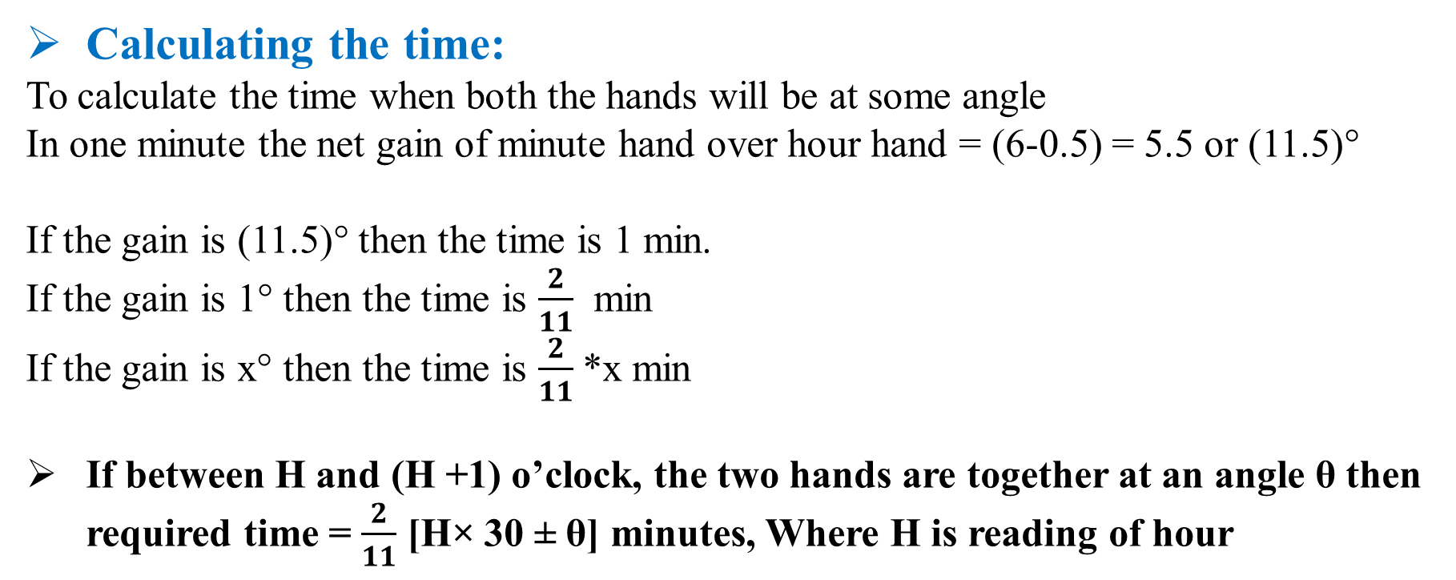
Calculating the time:
To calculate the time when both the hands will be at some angle
In one minute the net gain of minute hand over hour hand = (6-0.5) = 5.5 or (11.5)°
If the gain is (11.5)° then the time is 1 min.
If the gain is 1° then the time is $\frac{2}{11}$ min
If the gain is x° then the time is $\frac{2}{11}$*x min
If between H and (H +1) o’clock, the two hands are together at an angle θ then required time = $\frac{2}{11}$ [H× 30 ± θ] minutes, Where H is reading of hour

Slide 9
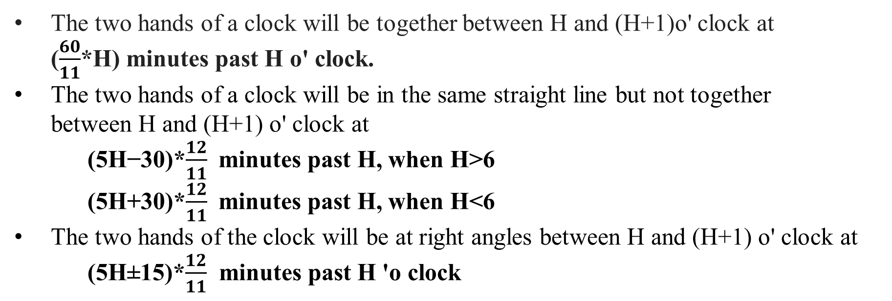
The two hands of a clock will be together between H and (H+1)o' clock at ($\frac{60}{11}$*H) minutes past H o' clock.
The two hands of a clock will be in the same straight line but not together between H and (H+1) o' clock at
(5H−30)*$\frac{12}{11}$ minutes past H, when H>6
(5H+30)*$\frac{12}{11}$ minutes past H, when H<6
The two hands of the clock will be at right angles between H and (H+1) o' clock at (5H±15)*$\frac{12}{11}$ minutes past H 'o clock

Slide 10
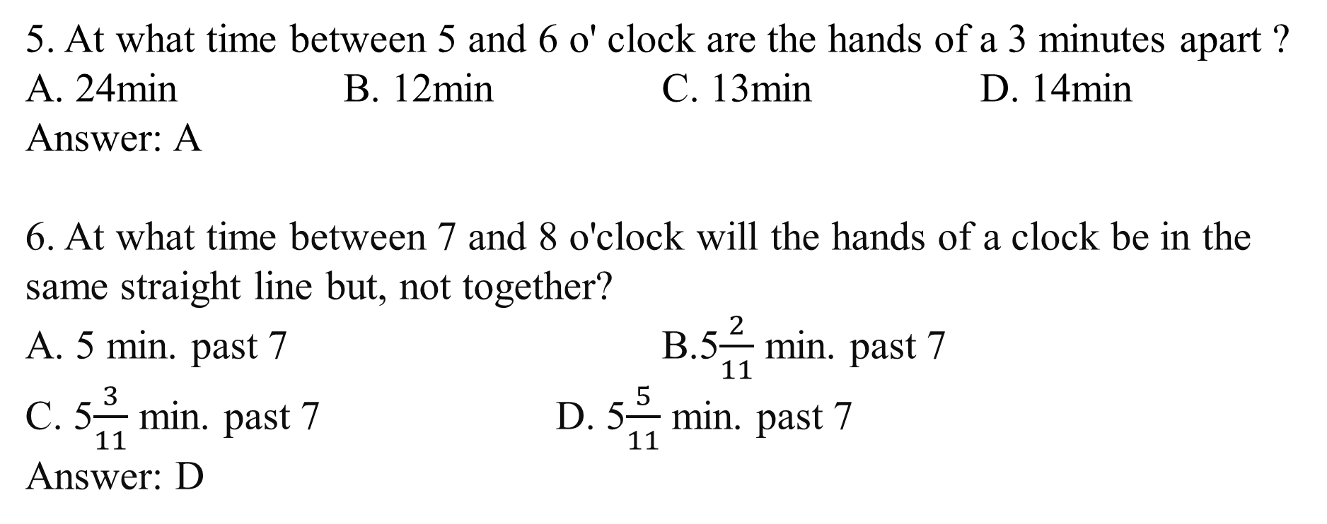
5. At what time between 5 and 6 o' clock are the hands of a 3 minutes apart ?
A. 24min B. 12min C. 13min D. 14min
Answer: A
6. At what time between 7 and 8 o'clock will the hands of a clock be in the same straight line but, not together?
A. 5 min. past 7 B.5$\frac{2}{11}$ min. past 7
C. 5$\frac{3}{11}$ min. past 7 D. 5$\frac{5}{11}$ min. past 7
Answer: D
Notes:
5. In this type of problems the formuae is (5*x+ or - t)*12/11 Here x is replaced by the first interval of given time. Here x is 5. t is spaces apart
Case 1 : (5*x + t) * 12/11
(5*5 + 3) * 12/11
28 * 12/11 = 336/11= min
therefore the hands will be 3 min apart at 31 5/11 min past 5.
Case 2 : (5*x - t) * 12/11
(5*5 -3 ) * 12/11
22 *12/11 = 24 min
therefore the hands will be 3 min apart at 24 min past 5

Slide 11
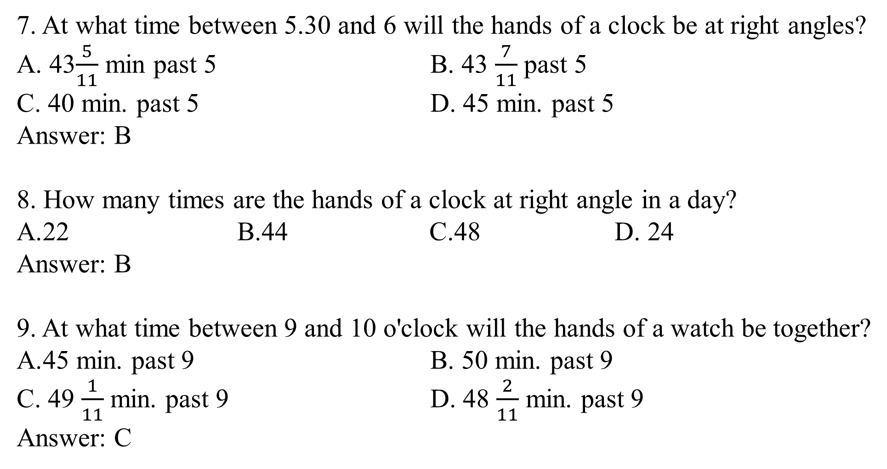
7. At what time between 5.30 and 6 will the hands of a clock be at right angles?
A. 43$\frac{5}{11}$ min past 5 B. 43 $\frac{7}{11}$ past 5
C. 40 min. past 5 D. 45 min. past 5
Answer: B
8. How many times are the hands of a clock at right angle in a day?
22 B.44 C.48 D. 24
Answer: B
9. At what time between 9 and 10 o'clock will the hands of a watch be together?
45 min. past 9 B. 50 min. past 9
C. 49 $\frac{1}{11}$ min. past 9 D. 48 $\frac{2}{11}$ min. past 9
Answer: C
Notes:
7. At 5 o'clock, the hands are 25 min. spaces apart.
To be at right angles and that too between 5.30 and 6, the minute hand has to gain (25 + 15) = 40 min. spaces.
55 min. spaces are gained in 60 min.
40 min. spaces are gained in (60*40/55)min =43(7/11)min
Required time =43(7/11) min past 5
8. In 12 hours, they are at right angles 22 times.
In 24 hours, they are at right angles 44 times.

Slide 12
10. How many times do the hands of a clock coincide in a day?
20 B.21 C.22 D.24
Answer: C
Notes:
9. To be together between 9 and 10 o'clock, the minute hand has to gain 45 min. spaces.
55 min. spaces gained in 60 min.
45 min. spaces are gained in (60*45/55) min or 49(1/11) min
The hands are together at 49(1/11) min past 9
10. The hands of a clock coincide 11 times in every 12 hours (Since between 11 and 1, they coincide only once, i.e., at 12 o'clock).
AM
12:00 1:05 2:11 3:16 4:22 5:27 6:33 7:38 8:44 9:49 10:55
PM
12:00 1:05 2:11 3:16 4:22 5:27 6:33 7:38 8:44 9:49 10:55
The hands overlap about every 65 minutes, not every 60 minutes.
The hands coincide 22 times in a day.

Slide 13
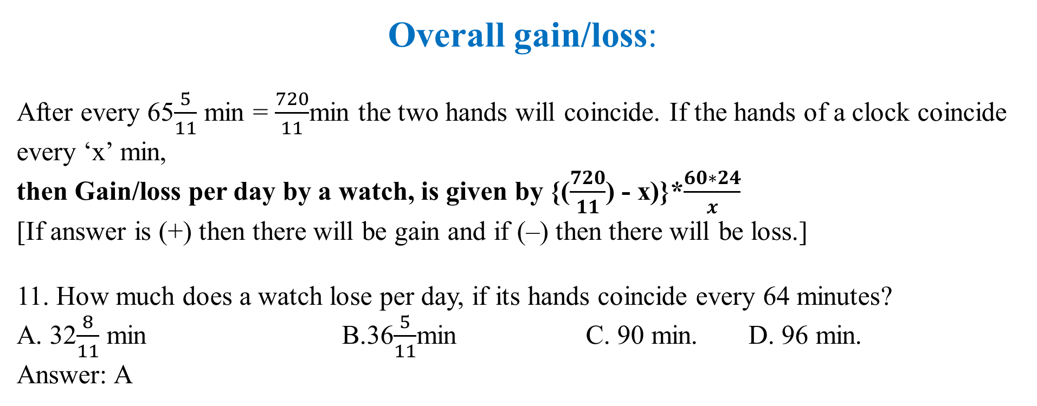
Overall gain/loss:
After every 65$\frac{5}{11}$ min = $\frac{720}{11}$min the two hands will coincide. If the hands of a clock coincide every ‘x’ min,
then Gain/loss per day by a watch, is given by {($\frac{720}{11}$) - x)}*$\frac{60∗24}{x}$
[If answer is (+) then there will be gain and if (–) then there will be loss.]
11. How much does a watch lose per day, if its hands coincide every 64 minutes?
A. 32$\frac{8}{11}$ min B.36$\frac{5}{11}$min C. 90 min. D. 96 min.
Answer: A

Slide 14
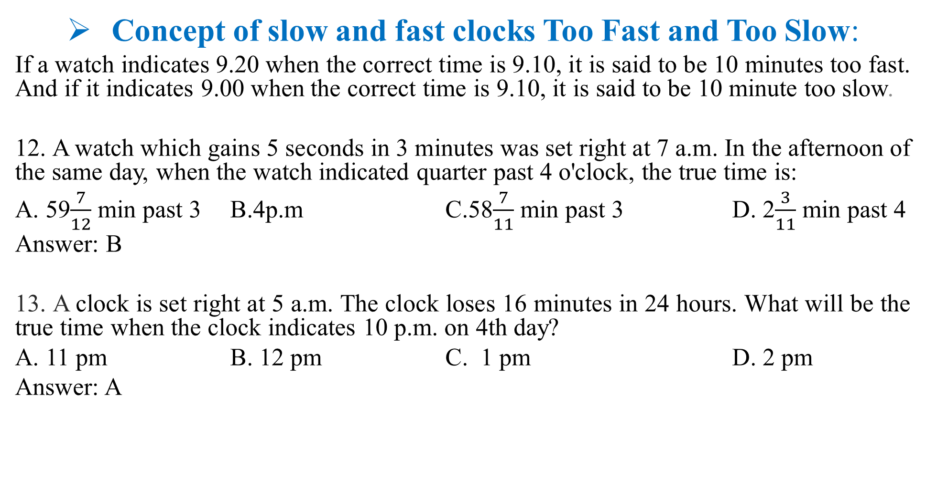
Concept of slow and fast clocks Too Fast and Too Slow:
If a watch indicates 9.20 when the correct time is 9.10, it is said to be 10 minutes too fast. And if it indicates 9.00 when the correct time is 9.10, it is said to be 10 minute too slow.
12. A watch which gains 5 seconds in 3 minutes was set right at 7 a.m. In the afternoon of the same day, when the watch indicated quarter past 4 o'clock, the true time is:
A. 59$\frac{7}{12}$ min past 3 B.4p.m C.58$\frac{7}{11}$ min past 3 D. 2$\frac{3}{11}$ min past 4
Answer: B
13. A clock is set right at 5 a.m. The clock loses 16 minutes in 24 hours. What will be the true time when the clock indicates 10 p.m. on 4th day?
A. 11 pm B. 12 pm C. 1 pm D. 2 pm
Answer: A

Slide 15
14. A watch which gains uniformly is 2 minutes slow at noon on Monday and is 4 min. 48 sec fast at 2 p.m. on the following Monday. When was it correct?
A. 2 p.m. on Tuesday B. 2 p.m. on Wednesday
C. 3 p.m. on Thursday D. 1 p.m. on Friday
Answer: B
15. A clock is set right at 8 a.m. The clock gains 10 minutes in 24 hours. What will be the true time when the clock indicates 1 p.m. on the following day?
A. 48 min. past 12 B. 46 min. past 12.
C. 45 min. past 12. D. 47 min. past 12.
Answer: A
Notes:
14. Time from 12 p.m. on Monday to 2 p.m. on the following Monday = 7 days 2 hours = 170 hours.
The watch gains (2+4(4/5))min or 34/5 min in 170 hrs
Now, 34/5 min. are gained in 170 hrs
2 min. are gained in (170*5/34*2)hrs= 50 hrs.
Watch is correct 2 days 2 hrs. after 12 p.m. on Monday i.e., it will be correct at 2 p.m. on Wednesday.

Slide 16


